Slide 1



Joint Transnational Call (JTC) 2017
for transnational research proposals in synergy with the two FET Flagships:
Graphene Flagship
Human Brain Project

Slide 2
What is FLAG-ERA?
FLAG-ERA is the FET Flagship supporting ERA-NET
  A network of National and Regional Funding Organisations (NRFOs) in Europe and beyond
  A coordination and support action supported by the European Commission (EC)
Main goals
  Set up, together with the two Flagship Core Projects and the EC, the mechanisms for using the existing national, regional and transnational calls in the framework of the Flagships
  Launch dedicated calls such as the FLAG-ERA JTC 2017

Slide 3
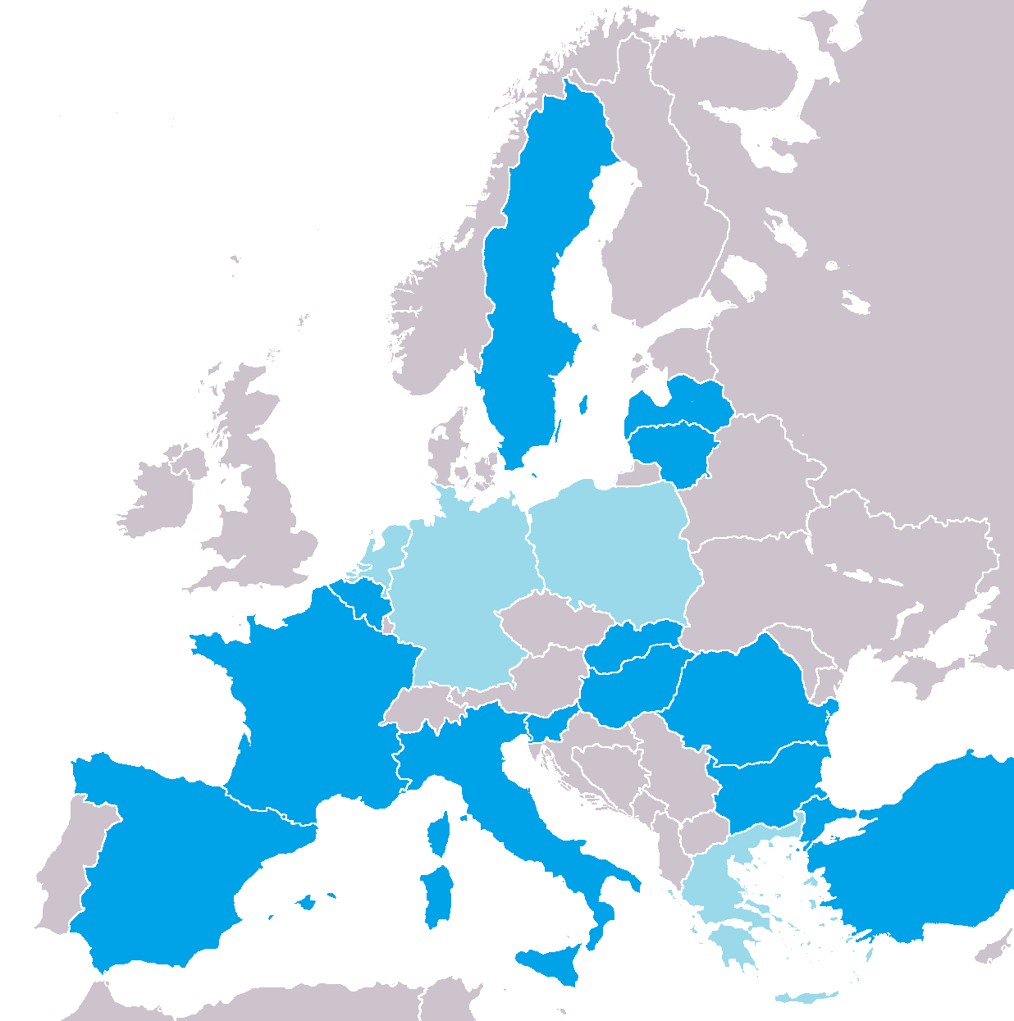
FLAG-ERA JTC 2017 overview
Joint call for transnational research proposals in synergy with the two FET Flagships
  Graphene Flagship
  Human Brain Project
Indicative budget: 16 M€
Deadline: March 14th, 2017
Participating countries
  Graphene Flagship:
  Human Brain Project:
BE | BG | DE | ES | FR | GR | HU | IT | LT | LV | NL | PL | RO | SE | SI | SK | TR
BE | BG |  | ES | FR |  | HU | IT | LT | LV |  |  | RO | SE | SI | SK | TR

Slide 4
An ERA-NET call tuned for the Flagships
Balance between the goal of selecting projects in synergy with the Flagships and the need for independence
  Scientific call text based on the Flagship inputs
  Information about foreseen synergies embedded in the submission
  Independent Scientific Evaluation Panel, informed about the Flagships
  Formal association process after publication of results
A transnational collaboration context provided by the Flagship
    3-country rule adapted to offer the possibility to request funding in only two countries while partnering with a Flagship Core Project member from a third one

Slide 5
Expected type of proposals
Transational
  at least 3 partners requesting funding from 3 different participating countries, or
  at least 2 partners requesting funding from 2 different participating countries + 1 Core Project partner from a different country and securing its own funding
With clear synergy with the Flagship
  Submission must include a description of the foreseen Flagship partnership (using the Flagship partnership proposal form)
  “Level of potential synergies with the Flagship” is an evaluation criterion

Slide 6
Other eligibility contraints
The consortium coordinator must be funded through the call
The consortium must be balanced
  Requested funding in a given country should not exceed 60% of the total requested funding (75% if funding is requested in 2 countries)
Project duration up to 3 years

Slide 7
Research Areas - Graphene
Basic Research
Applied Research and Innovation
Synthesis and characterization of Layered Materials (LMs) beyond graphene
Large scale production of heterostructures based on LMs
Vertical and lateral epitaxy of Graphene and Related Materials (GRMs) for optoelectronics
Functional ceramics incorporating GRMs
Inks for printing stable, GRM-based, semiconducting thin films
Modelling charge and heat transport in GRM-based composites
Ecotoxicology of GRMs
Nanofluidics using GRMs
Novel device concepts based on GRMs for quantum communication
Beyond CMOS switches and new computing paradigms based on GRMs
In-situ and ex-situ quality control of GRMs
Controlling doping in high quality large-area graphene
GRMs for smart textiles
Functional coatings using GRMs
GRMs for corrosion prevention and as lubricants
GRMs for thermal management and thermoelectrics
Biorecognition of specific disease markers using GRMs
Highly selective gas sensors based on GRMs
GRM-based bioelectronic technologies

Slide 8
Research Areas – HBP
Basic and Applied Research
Human brain intracranial data and their relationship to other aspects of brain organisation
Comparing morphology and physiology of cortical cell types in human and non-human primates
Comparative aspects of brain function and connectivity
Cross-species multi-scale data constraints for visuo-motor integration
The neural bases of spatial navigation and episodic memory
Models of auditory processing
Dynamics and representation in multi-level systems of human cognitive functions
Modelling dendrites within active networks
Testing predictive coding and attractor network models
Biological deep learning
Disease modelling and simulation
Innovative modelling for allosteric drug discovery
Integration of simulation tools, neuromorphic computing and robotics with brain and behavioural studies for developing next-generation brain-computer interfaces
Text mining of cellular, synaptic, connectomic or functional properties of the brain

Slide 9
Indicative Budgets (k€)
 |  |  | Graphene |  | HBP | Anticipated nb of fundable research groups
Country |  | Funding organisation | Basic research | Applied research and innovation | Basic and applied research
BE | Belgium | FNRS | 200 | - | 200 | 2
 |  | FWO | 500 |  | 500 | 2-4
BG | Bulgaria | BNSF | 175 | - | 175 | 2-3
DE | Germany | DFG | 2000 | - | - | 10-12
ES | Spain | MINECO | 560 |  | 560 | 6-9
FR | France | ANR | 1250 |  | 1250 | 8-10
GR | Greece | GSRT | 500 | 200 | - | 7
HU | Hungary | NKFIH | 250 |  | 250 | 4
IT | Italy | MIUR | - | 100 | 100 | 2
LT | Lithuania | LMT | 100 |  | 100 | 2
LV | Latvia | VIAA | 200 |  | 200 | 2-3
NL | Netherlands | FOM | 1000 | - | - | 3-4
PL | Poland | NCBR | - | 500 | - | 2-3
RO | Romania | UEFISCDI | 250 |  | 250 | 6-8
SE | Sweden | VR & VINNOVA | 500 | 500 | 500 | 4-8
SI | Slovenia | MIZS | 210 |  | 420 | 3
SK | Slovakia | SAS | 240 |  | 240 | 4-5
TR | Turkey | TUBITAK | 1000 |  | 1000 | 5-6
 |  | Total | 10235 |  | 5745

Slide 10
Main steps after submission
Pre-proposals are assessed by a independent international Scientific Evaluation Panel (SEP). Top ranked proposals are selected for full proposal submission (cumulated amount of requested funding is max 3 times available budget).
Full proposals are evaluated by the SEP with the help of external reviewers. A ranking list of projects recommended for funding is established on the basis of this second assessment and of the available funding.
All partners in these projects who are not already Flagship Core Project members are expected to join the Flagships as associated members
Timeline
  End May 2017: Notification of accepted short proposals
  July 2017: Full proposal submission deadline
  October 2017: Notification of accepted full proposals
  December 2017 – March 2018: Project start (up to 3 years)
  2018-2020: Yearly project follow-up seminars

Slide 11
Comparison with national calls
JTC 2017 | National and regional calls
Topic definition is based on Flagship inputs | Topics are defined independently of the Flagships
Strong synergy with the Flagship is favoured (synergy is an evaluation criterion) | Synergy with the Flagship can be a plus for the evaluation
Funding requested in 2+ countries | Funding requested in 1 country
Only some countries participate | All countries have calls
Smaller budgets | Larger budgets overall
Compete only with proposals fitting the JTC constraints | Compete with all proposals in the domain

Slide 12
Further information
Call Announcement, submission form, electronic submission site:
http://www.flagera.eu
National and regional contact points:
Call Announcement (Annex II)
Joint Call Secretariat:
fabien.guillot@agencerecherche.fr
Graphene Flagship
Point of Contact:
graphene-eu@esf.org
Human Brain Project
Point of Contact:
relations@humanbrainproject.eu

